Slide 1



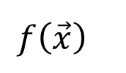
X1
X0=1
w1
w0
$$Σ$$
X2
w2
$$f\left(\vec{x}\right)$$
$$\sum_{i=0}^{n}{w_{i}x_{i}}$$
.
$$f\left(\vec{x}\right)=sgn\left(\vec{w}∙\vec{x}\right)$$
.
wn
.
Xn

Slide 2
X1
X0=1
w1
w0
$$Σ$$
X2
w2
.
.
wn
.
Xn

Slide 3
X2
X2
X1
X1
a)
b)

Slide 4
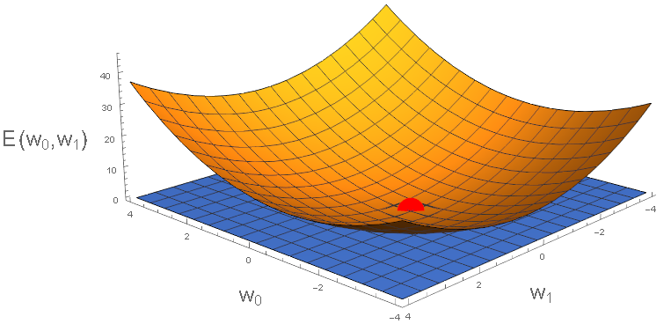

Slide 5












Information
Layer 1
Layer 2
$$w_{MD}^{(1)}$$
$$f_{M}^{(1)}$$
$$w_{KM}^{(2)}$$
$$x_{D}$$
.
.
$$f_{K}^{(2)}$$
.
.
.
.
.
.
Inputs
.
Outputs
$$x_{1}$$
$$f_{1}^{(2)}$$
$$f_{1}^{(1)}$$
$$x_{0}$$
$$w_{10}^{(1)}$$
$$w_{10}^{(2)}$$
$$f_{0}^{(1)}$$

